Slide 1
Policy Instruments -2
Taxes
Plastic bag levy
Subsidies
Tradable permits
Sulphur permits
Taxes v permits
A comparison

Slide 2
0 Introduction
1 Social choice
2 Externalities and public goods
3 Decision analysis
4 Valuation: Aims and purpose
5 Valuation: Revealed preferences
6 Valuation: Stated preferences
7 Direct regulation
8 Market-based instruments
SPRING BREAK
9 Complications with instruments Growth and justice
10 Growth and the environment Green accounting
11 Green accounting Exam preparation

Slide 3
Policy Instruments -2
Taxes
Plastic bag levy
Subsidies
Tradable permits
Sulphur permits
Taxes v permits
A comparison

Slide 4
Taxes and Subsidies
Taxes: Pay a charge or levy or penalty for every unit consumed, produced or emitted

Slide 9
Plastic Bag Levy
The most popular tax in Europe?
Ireland introduced a €0.15/bag levy in 2002, against the will of the people

Slide 10
Plastic Bag Levy
Ireland introduced a €0.15/bag levy in 2002
Annual revenue around €13,000,000
Fixed cost €1,200,000
Awareness campaign €360,000
Variable costs €350,000
Costs low because the levy is just another excise, could be integrated into existing systems to collect excise and VAT

Slide 11
Plastic Bag Levy
Areas with no plastic litter increased by 21%, areas with little litter by 56%
Plastic in household waste fell from 5% to 0.2%
Retailers positive, cost savings
Public happy too

Slide 12
Plastic Bag Levy
Denmark had a plastic bag levy before Ireland
Other countries followed, not just in Europe
Wales 5p/bag since 2010
Plastic bag use fell 71% (single use), 57% (overall)
Money donated to good causes
Enforcement unclear
Government estimates £17-22 million donated between 2011 and 2014
Scotland since 2014, England since 2015

Slide 13
Policy Instruments -2
Taxes
Plastic bag levy
Subsidies
Tradable permits
Sulphur permits
Taxes v permits
A comparison

Slide 14
Taxes and Subsidies
Taxes: Pay a charge or levy or penalty for every unit consumed, produced or emitted
Subsidies: Receive a premium for every unit not consumed, produced or emitted
Different effects on emissions in the short-run?

Slide 15
If you reduce emissions, you pay less tax.
If you increase emissions, you pay more tax.

Slide 16
If you reduce emissions, you pay less tax, or get more subsidy.
If you increase emissions, you pay more tax, or get less subsidy.

Slide 17
Taxes and Subsidies
Taxes: Pay a charge or levy or penalty for every unit consumed, produced or emitted
Subsidies: Receive a premium for every unit not consumed, produced or emitted
Taxes and subsidies have the same effect on emissions in short-run
Uniform taxes and subsidies have a uniform effect on marginal production costs
This ensures cost-effectiveness (see below)
Same effect in the long-run?

Slide 22
Taxes and Subsidies
Taxes: Pay a charge or levy or penalty for every unit consumed, produced or emitted
Subsidies: Receive a premium for every unit not consumed, produced or emitted
Uniform taxes and subsidies have a uniform effect on marginal production costs, thus ensuring cost-effectiveness (see below)
Taxes and subsidies have an equivalent effect on emissions in the short run, but have different long-term effects
Taxes and subsidies have different budgetary, distributional effects too

Slide 23
Policy Instruments -2
Taxes
Plastic bag levy
Subsidies
Tradable permits
Sulfur permits
Taxes v permits
A comparison

Slide 24
Tradeable Permits
The government sets an overall target on consumption, production or, most common, emissions
Each producer obtains a certain amount of emission permits, can sell these, or buy more at the market place

Slide 27
Tradeable Permits
The government sets an overall target on consumption, production or, most common, emissions
Each producer obtains a certain amount of emission permits, can sell these, or buy more at the market place
If the permit market is perfect, all producers pay the same price, and marginal costs of production increase uniformly
Taxes and tradeable permits are equivalent provided that the regulator knows all marginal abatement costs

Slide 28
Sulfur permits
Title IV of the Clean Air Amendments of 1990 capped sulfur emissions of the dirtiest 263 power generators for 1995-1999
22% of heat input, 17% of capacity
After 2000, many more included
Emissions are monitored, $124,000/unit/year
Units can freely trade and bank permits

Slide 30
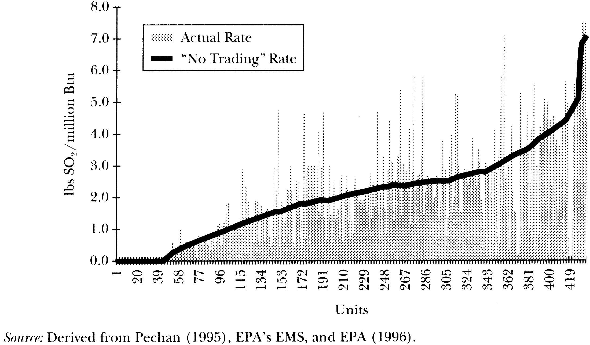

Slide 32
Sulfur permits
Costs much lower than expected
Technology pessimism in models

Slide 34
Sulfur permits
Costs much lower than expected
Technology pessimism in models
At first, large spread in bids – buyers uncertain about the price
Disappeared in two years
Consultants and brokers also quickly disappeared
Success explains popularity of cap-and-trade

Slide 35
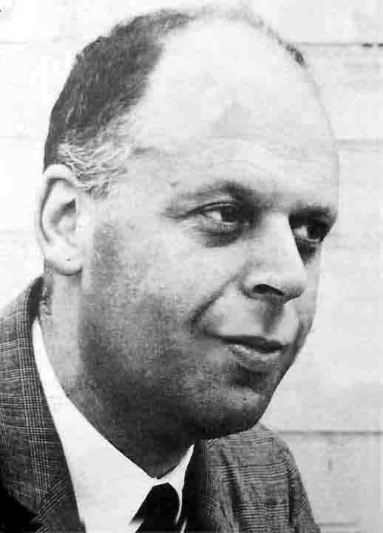
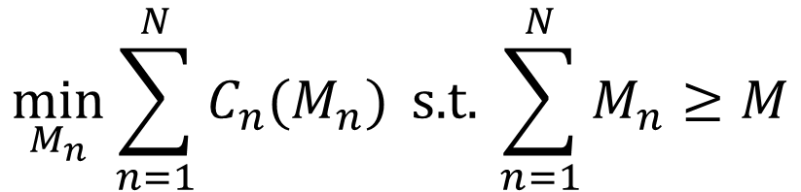

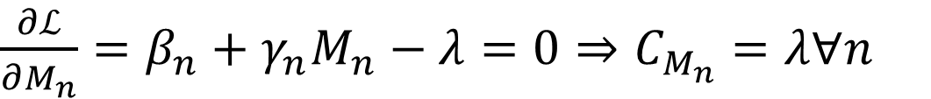
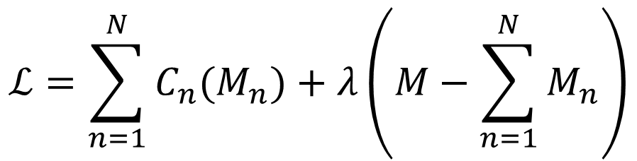
Cost-effectiveness -2
$$C_{n}=β_{n}M_{n}+0.5γ_{n}M_{n}^{2}$$
$$\min_{M_{n}}{\sum_{n=1}^{N}{C_{n}(M_{n})}} \text{s}\text{.}\text{t}\text{. }\sum_{n=1}^{N}{M_{n}}≥M$$
Marginal costs are equal for all polluters.
$$ℒ=\sum_{n=1}^{N}{C_{n}(M_{n})}+λ\left(M−\sum_{n=1}^{N}{M_{n}}\right)$$
$\frac{∂ℒ}{∂M_{n}}=β_{n}+γ_{n}M_{n}−λ=0⇒C_{M_{n}}=λ∀n$

Slide 36
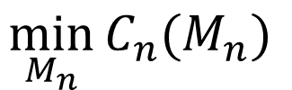
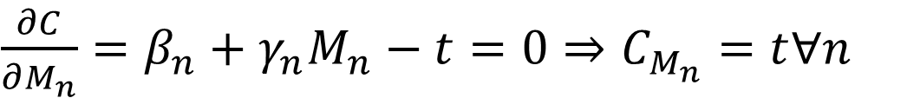
Cost-effectiveness -3
$$C_{n}=β_{n}M_{n}+0.5γ_{n}M_{n}^{2}−tM_{n}$$
If you reduce emissions,
tax falls and so costs fall
$$\min_{M_{n}}{C_{n}(M_{n}) }$$
Marginal costs are equal for all polluters.
$\frac{∂C}{∂M_{n}}=β_{n}+γ_{n}M_{n}−t=0⇒C_{M_{n}}=t∀n$
If you reduce emissions,
subsidy increases and
so costs fall
$$C_{n}=β_{n}M_{n}+0.5γ_{n}M_{n}^{2}−sM_{n}$$
$$C_{n}=β_{n}M_{n}+0.5γ_{n}M_{n}^{2}−pM_{n}$$
Subsidy if permit seller,
tax if permit buyer

Slide 37
Policy Instruments -2
Taxes
Plastic bag levy
Subsidies
Tradable permits
Sulphur permits
Taxes v permits
A comparison

Slide 38

Taxes vs Cap & Trade
Taxes and tradable permits are similar
Both reduce emissions
Both equate abatement costs at the margin
If auctioned, both bring government revenue
The environmental effect of taxes is uncertain (but its marginal costs are certain)
The environmental effect of tradeable permits is certain (but its costs are uncertain)
Taxes and tradeable permits are equivalent under certainty
Which one is better under uncertainty?

Slide 39
Weitzman Theorem: Preliminaries
True marginal costs
Assumed marginal costs
Marginal damages
Price
p’
p*
Price instrument: overregulation
Welfare loss underregulation
Welfare loss overregulation
p”
q”
q*
q’
Quantity
Quantity instrument: underregulation

Slide 40
Weitzman Theorem: MD steeper than MC
Marginal damages
True marginal costs
Assumed marginal costs
Price
p’
p*
Price instrument: overregulation
Welfare loss underregulation
Welfare loss overregulation
p”
q”
q*
q’
Quantity
Quantity instrument: underregulation

Slide 41
Weitzman Theorem: MD less steep than MC
True marginal costs
Assumed marginal costs
Price
Marginal damages
p’
p*
Price instrument: overregulation
Welfare loss underregulation
Welfare loss overregulation
p”
q”
q*
q’
Quantity
Quantity instrument: underregulation

Slide 42
Weitzman Theorem: MD as steep as MC
True marginal costs
Assumed marginal costs
Marginal damages
Price
p’
p*
Price instrument: overregulation
Welfare loss underregulation
Welfare loss overregulation
p”
q”
q*
q’
Quantity
Quantity instrument: underregulation

Slide 43
Weitzman Theorem
If the marginal damage cost curve is less steep than the marginal abatement cost curve, then mistakes with price instruments (taxes) are less costly than are mistakes with quantity instruments (tradable permits)
If the marginal damage cost curve is steeper than the marginal abatement cost curve, then mistakes with quantity instruments (tradable permits) are less costly than are mistakes with price instruments (taxes)

Slide 44
Policy Instruments -2
Taxes
Plastic bag levy
Subsidies
Tradable permits
Sulphur permits
Taxes v permits
A comparison

Slide 45
Criteria
Cost-effectiveness
Administrative costs
Information requirements
Environmental effectiveness
Enforceability
Long-run effects and dynamic efficiency
Flexibility and uncertainty
Equity

Slide 46
Cost-Effectiveness
Direct regulation is unlikely to be cost-effective, unless the regulator knows a lot and the industry is homogenous
Institutional instruments may be cost-effective (voluntary agreements), and even efficient (bargaining, property rights)
Taxes, subsidies, and tradable permits are cost-effective by design (barring exemptions)

Slide 47
Administrative costs
Command and control is expensive, and that makes it attractive to a self-interested regulator
Some institutional instruments are cheap (voluntary agreements, property rights), others may be expensive (courts)
Taxes and subsidies are very cheap if based on existing monitoring and fiscal instruments
Tradable permits are cheap

Slide 48
Environmental Effectiveness
The environmental effect of taxes and subsidies is uncertain (but its marginal costs are certain)
The environmental effect of tradeable permits is certain (but its costs are uncertain)
The environmental effects of emission standards are certain (bar illegal dumping), of input and production standards less certain
The environmental effects of institutional instruments are uncertain, and unpredictable as enforcement is not in the hands of the government

Slide 49
Dynamic Effects
Taxes and tradeable permits provide a continuous incentive to emit less
Subsidies have the same effect, but may attract new entrants
Direct regulation is static; once the standard is met, there is no need to further reduce emissions
Unless, standards get (conditionally) stricter over time

Slide 50
Flexibility
Flexibility is important, as new information may arise
It is easy to lower taxes, make standards less strict; it is hard to do the opposite
The exception is tradeable permits, where the government can release new permits but also buy existing ones
With tradeable permits, people buy (hold) but not use (sell) permits and thus correct government policy, perhaps leading to efficiency

Slide 51
Equity
Different instruments have different distributional consequences
In general, environmental policy makes things more expensive; with cost-effective instruments, this effect and hence the distributional effects are less pronounced
If necessary (luxury) goods are regulated, the environmental policy is regressive (progressive)
Tax revenue can be used to compensate distributional effects, as can the revenue of a permit auction. The initial permit allocation can also be used as compensation in kind

